Slide 1
PLANT SPECIES & LEAF DISEASE CLASSIFICATION
MAJOR PROJECT (BTECH CSE)

Slide 2
INTRODUCTION
Plants are the backbone of all life and there are about 40 million plant species on Earth providing us with oxygen, food and many essential products helping for the existence of human life. A good understanding of plants is essential to help in the process of identification of new or rare plant species to improve the balance in the ecosystem.

Slide 3
INTRODUCTION
Agriculture is one of the most difficult fields to contain for the purpose of Statistical Quantification.
Even within a single field, conditions are always changing from one section to the next. Growers may feel their prospects are Good for an upcoming Harvest, but until that day arrives, the outcome will always be uncertain.
Today, more investment and innovation is needed in agriculture to feed more than 10 billion people by 2050.
The fourth agricultural revolution is already on its way.

Slide 4
PROBLEM STATEMENT
In the developing world, more than 80 percent of the agricultural production is generated by smallholder farmers
Yield loss of more than 50% due to pests and diseases are common
Diseases remain a major threat to this supply, and a large fraction of crops are lost each year to diseases.

Slide 5
SOLUTION
Wouldn't it be great if the smartphone could be turned into a disease diagnostics tool, recognizing diseases from images it captures with its camera?

Slide 6
SOLUTION
Platform : Mobile app , Web app or a Chat Bot
Input: User capture an image of the infected crop.
Output: the name of the crop and the name of the infected disease
Added Benefit: removal of language barrier

Slide 7
LITERATURE SURVEY
Traditionally, farmers and experts would identify diseases just by visually inspecting plants, but this method can be slow and sometimes inaccurate.
To overcome this, researchers around the world have started using technology—especially computer vision and machine learning—to automate the process.
One popular approach is using Convolutional Neural Networks (CNNs) to analyze leaf images and detect diseases.
New tools like deep learning, hyperspectral imaging, and even mobile apps are making it easier than ever to detect plant diseases quickly and accurately, right from the field.

Slide 8
Sl. No. | Title | Author(s) | Approach Used | Contributions / Model Used | Evaluation Metrics
1 | Plant Disease Detection Using Deep Convolutional Neural Network | M. K. R. Reddy, S. P. Kumar, et al. | Custom CNN | Developed a 14-layer CNN (14-DCNN) trained on augmented datasets; converted model to TensorFlow Lite for mobile deployment. | Training Accuracy: 99.993%, Validation Accuracy: 99.985%
2 | Deep Learning-Based Leaf Disease Detection in Crops Using Images for Agricultural Applications | S. Sharma, A. Singh, et al. | Transfer Learning | Fine-tuned pre-trained models (DenseNet-121, ResNet-50, VGG-16, Inception V4) on the PlantVillage dataset; addressed multi-class, multi-label classification challenges. | Accuracy, Sensitivity, Specificity, F1 Score
3 | Using Deep Learning for Image-Based Plant Disease Detection | S. P. Mohanty, D. Hughes, M. Salathé | Custom CNN | Trained a deep CNN on 54,306 images to identify 14 crop species and 26 diseases; demonstrated feasibility of smartphone-assisted disease diagnosis. | Accuracy: 99.35% on test set
4 | Explainable Vision Transformer Enabled Convolutional Neural Network for Plant Disease Identification: PlantXViT | P. S. Thakur, P. Khanna, T. Sheorey, A. Ojha | Vision Transformer + CNN | Proposed PlantXViT, combining CNNs with Vision Transformers; evaluated on five datasets; emphasized model explainability using Grad-CAM and LIME techniques. | Accuracy: >93.55% (Apple), >92.59% (Maize), >98.33% (Rice)
5 | Plant Leaf Disease Detection Using Deep Learning: A Multi-Dataset Approach | K. Meghraoui, I. Sebari, J. Pilz, et al. | Transfer Learning | Employed multiple datasets and deep learning models for robust plant disease detection; addressed challenges in dataset variability and model generalization. | Not specified
6 | Plant Disease Detection Using Image Processing and Machine Learning | P. Kulkarni, A. Karwande, T. Kolhe, S. Kamble, A. Joshi, M. Wyawahare | Machine Learning | Proposed a technique combining image processing with machine learning algorithms for efficient crop disease detection; aimed to reduce reliance on skilled labor. | Not specified
7 | Plant Disease Detection and Classification Using Deep Learning | M. M. Qureshi, M. M. Iqbal, S. Ramzan, S. Majeed, M. S. Bashir | Transfer Learning + Custom CNN | Developed an end-to-end framework for tomato leaf disease identification using both transfer learning and custom CNN architectures; achieved high classification accuracy on unseen samples. | Accuracy: 92% on unseen samples
8 | A Deep Learning Enabled Multi-Class Plant Disease Detection Model Based on Computer Vision | A. F. Fuentes, S. Yoon, S. C. Kim, D. S. Park | Deep Learning | Developed a robust deep learning-based detector for real-time tomato plant diseases and pests recognition; emphasized real-time application and high performance. | Not specified
9 | An open access repository of images on plant health to enable the development of mobile disease diagnostics | David P. Hughes, Marcel Salathé | Dataset / Survey / Other | Developed an open dataset (PlantVillage) for plant disease detection | Not specified
10 | On Using Transfer Learning for Plant Disease Detection | Abhinav Sagar, Dheeba Jacob | Transfer learning | Used pre-trained VGG16 and ResNet architectures for classification | Accuracy, Precision, Recall

Slide 9
OBJECTIVE
Identify Plant Species.
Classify Leaf Diseases
Develop a Robust CNN Model
Leverage Pre-trained Models
Contribute to Sustainable Agriculture

Slide 10
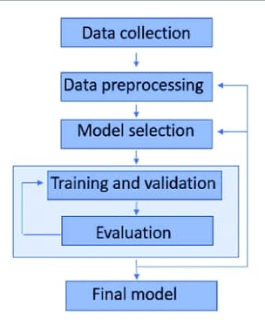
METHODOLOGY

Slide 11
IMPLEMENTATION
To bring our project to life, we trained machine learning models from scratch and also explored transfer learning to boost performance.
Transfer learning helped us save time and resources by using powerful pre-trained models which gave us a strong foundation and allowed our system to recognize plant diseases more accurately, even with a limited dataset.
Dataset
ML Architecture
Model Training
Evaluation

Slide 12
TRAINING A MODEL FROM SCRATCH
USING TENSORFLOW / PYTORCH

Slide 13
DATASET USED
Aspect | Details
Dataset Name | Custom PlantVillage Dataset
Source | Publicly available on Kaggle
Total Images | ~87,000
Number of Classes | 38 (including healthy and diseased classes)
Image Categories | Tomato, Potato, Maize, Apple, Grape, etc.
Diseases Covered | Early Blight, Late Blight, Leaf Mold, Healthy, etc.
Image Format | JPEG
Input Image Size | Resized to 128 × 128 × 3
Train/Val Split | 80% / 20%
Preprocessing Steps | Resizing, normalization
Data Augmentation | Rotation, flipping, zoom

Slide 14
TECHNICAL DETAILS OF MODEL TRAINING
Component | Details
Framework | TensorFlow & Keras
Input Size | 128 × 128 × 3
Conv Blocks | 5 blocks
Filter Sizes | From 32 to 512
Pooling | MaxPooling2D after Conv blocks
Regularization | Dropout layers added
Dense Layer | 1500 units
Output Layer | Softmax, 38 categories
Optimizer | Adam
Loss Function | Categorical Crossentropy
Dataset | Custom leaf image dataset

Slide 15
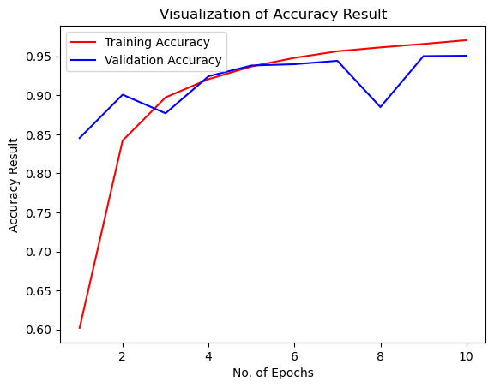
RESULTS

Slide 16
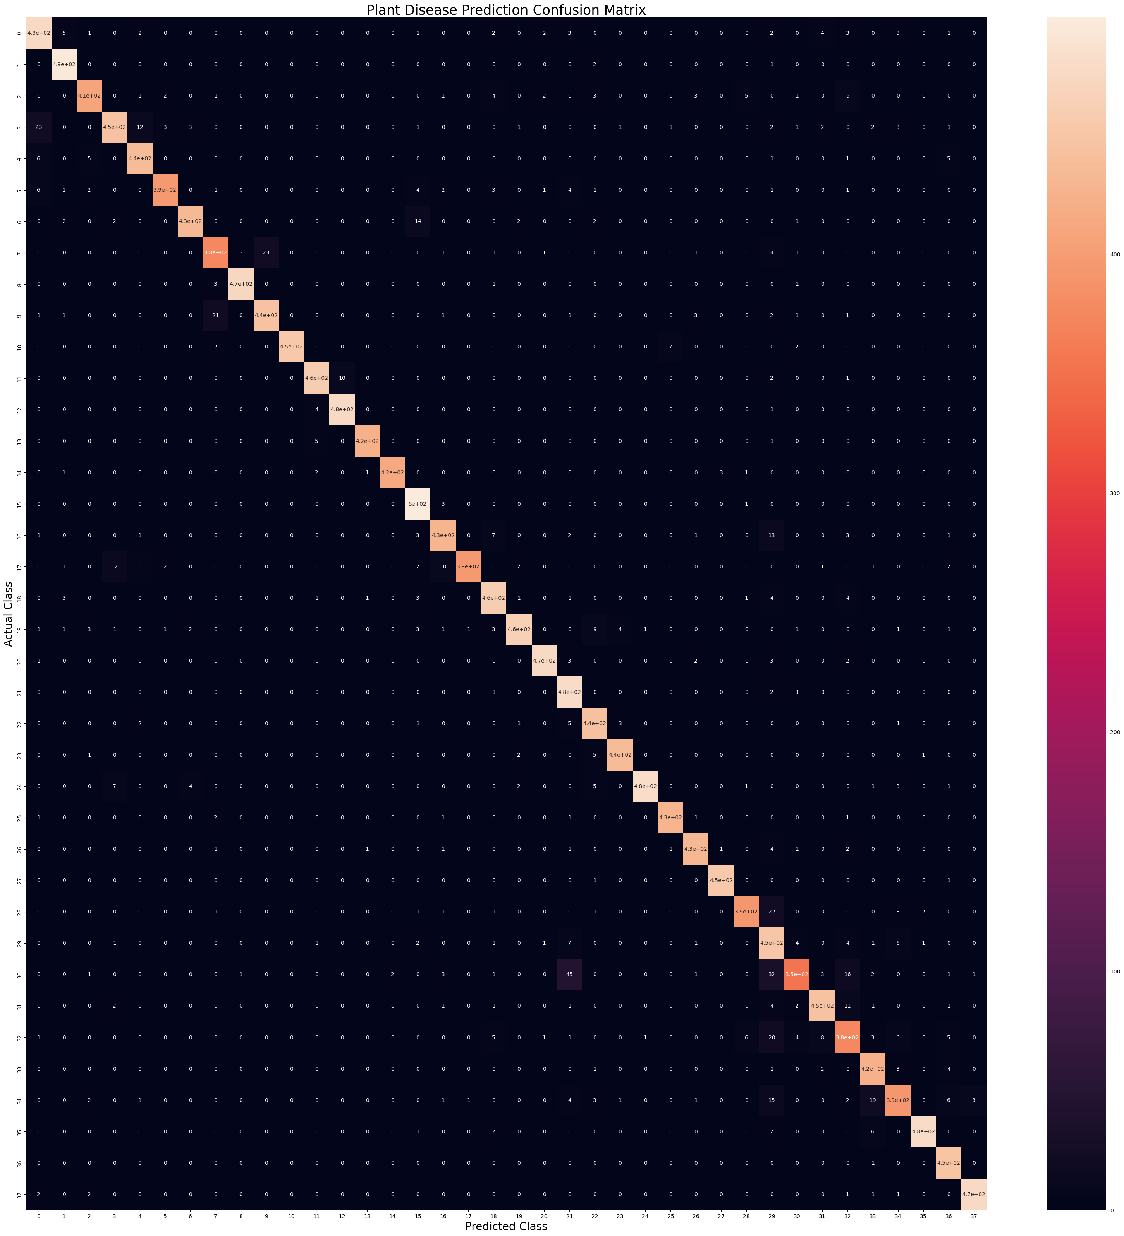
CONFUSION MATRIX FOR
THE MODEL

Slide 17
TRANSFER LEARNING BASED MODELS
FOR IMAGE CLASSIFICATION

Slide 18
PRE-TRAINED MODELS USED
Model | Type | Purpose
ResNet50 | CNN (50 layers) | Strong base model for classification or feature extraction
MobileNetV2 | Lightweight CNN | Optimized for mobile and edge devices
EfficientNetB0 | Scalable CNN | Balances accuracy and efficiency

Slide 19
DATASET
Dataset source: Plant Village Dataset (diseases verified by expert plant pathologists)
The original data records contain around 50,000 images.
The images span 14 crop species: Apple, Blueberry, Cherry, Corn, Grape, Orange, Peach, Bell Pepper, Potato, Raspberry, Soybean, Squash, Strawberry, Tomato.
Diseased crop images include 17 fungal diseases, 4 bacterial diseases, 2 mold (oomycete) diseases, 2 viral disease, and 1 disease caused by a mite.

Slide 20
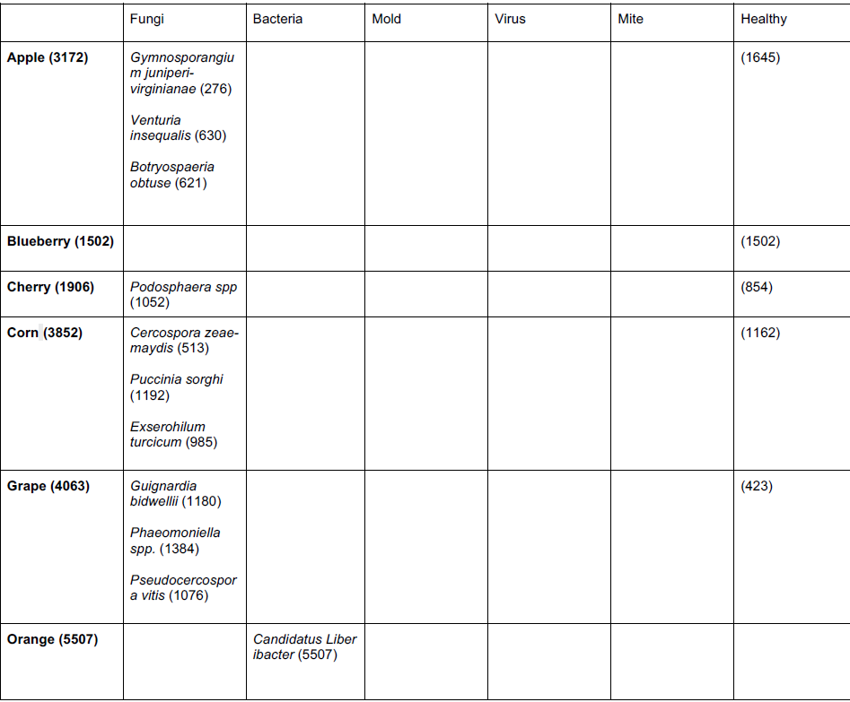
LIST OF CROPS AND THEIR DISEASE IN THE PLANT VILLAGE DATASET (OPEN-SOURCE)

Slide 21
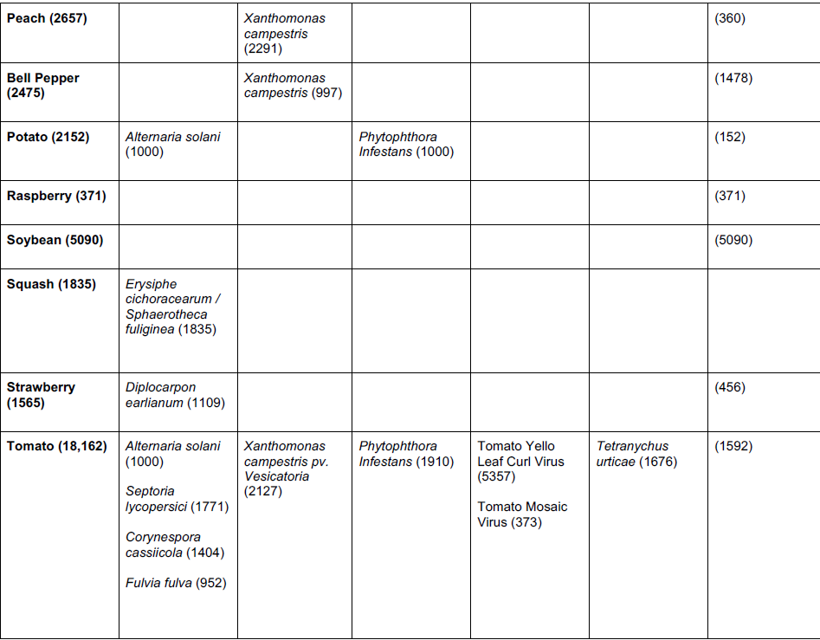
LIST OF CROPS AND THEIR DISEASE IN THE PLANT VILLAGE DATASET (OPEN-SOURCE)

Slide 22
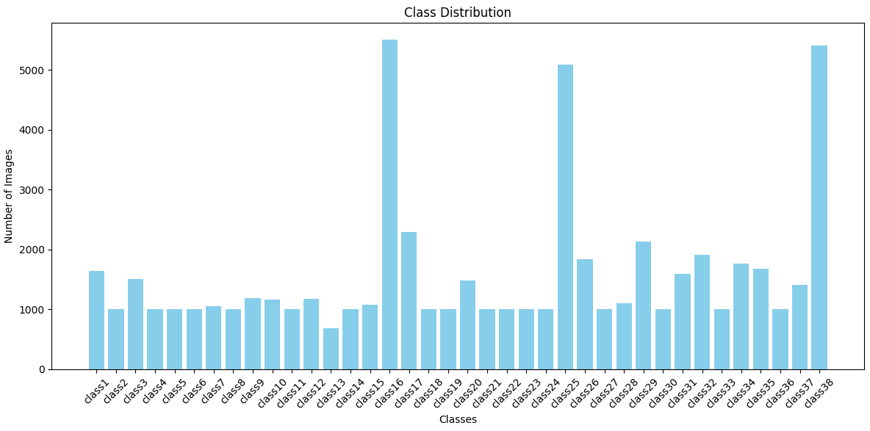
Class Distribution of Whole Dataset

Slide 23
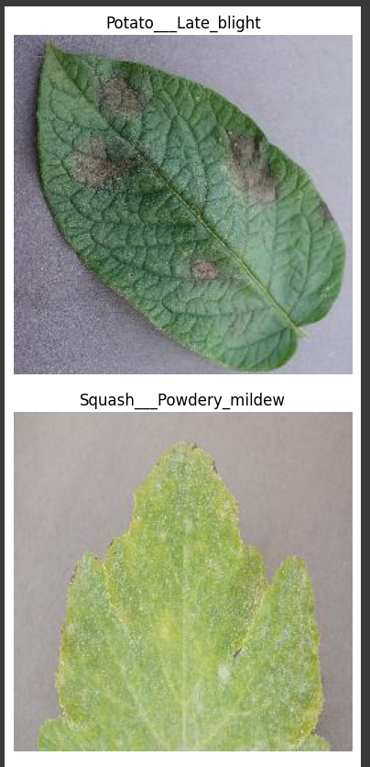
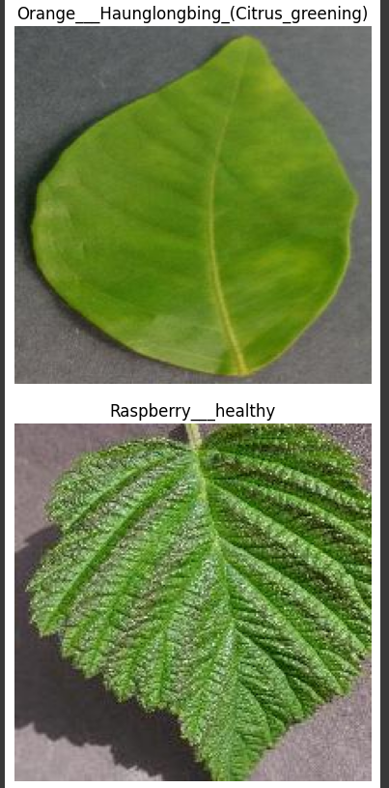
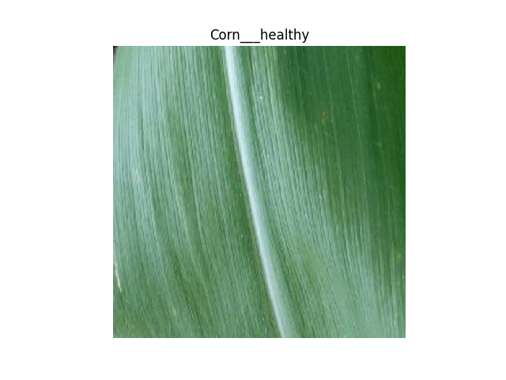
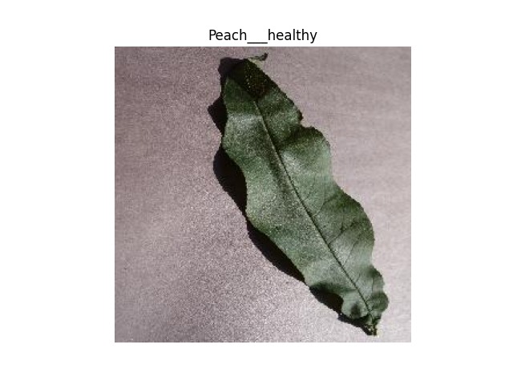
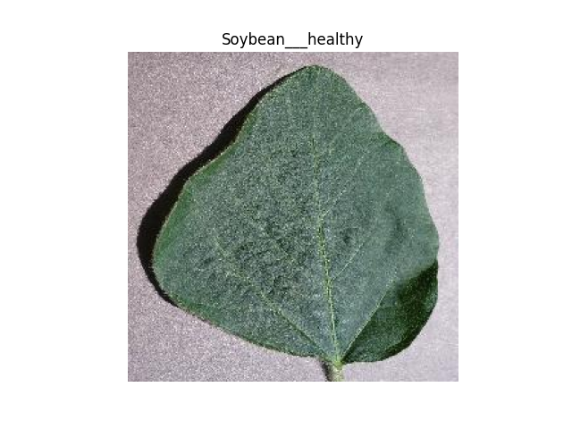
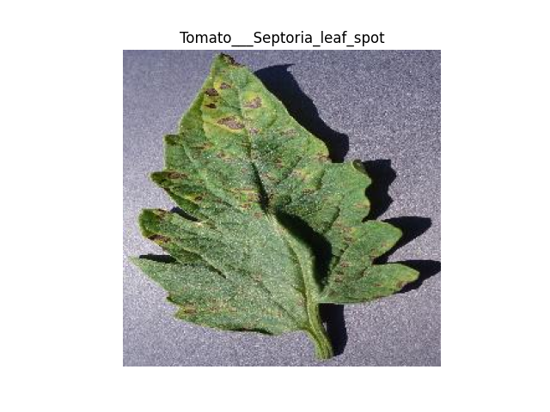
SAMPLE
IMAGES

Slide 24
TECHNICAL DETAILS OF MODEL TRAINING
Parameter | Value
Input Size | 224 × 224 × 3
Optimizer | Adam
Loss Function | Categorical Crossentropy
Epochs | 10
Batch Size | 32
Learning Rate | 0.0001
Validation Split | 20%
Augmentation | Yes (Rotation, Flip)

Slide 25
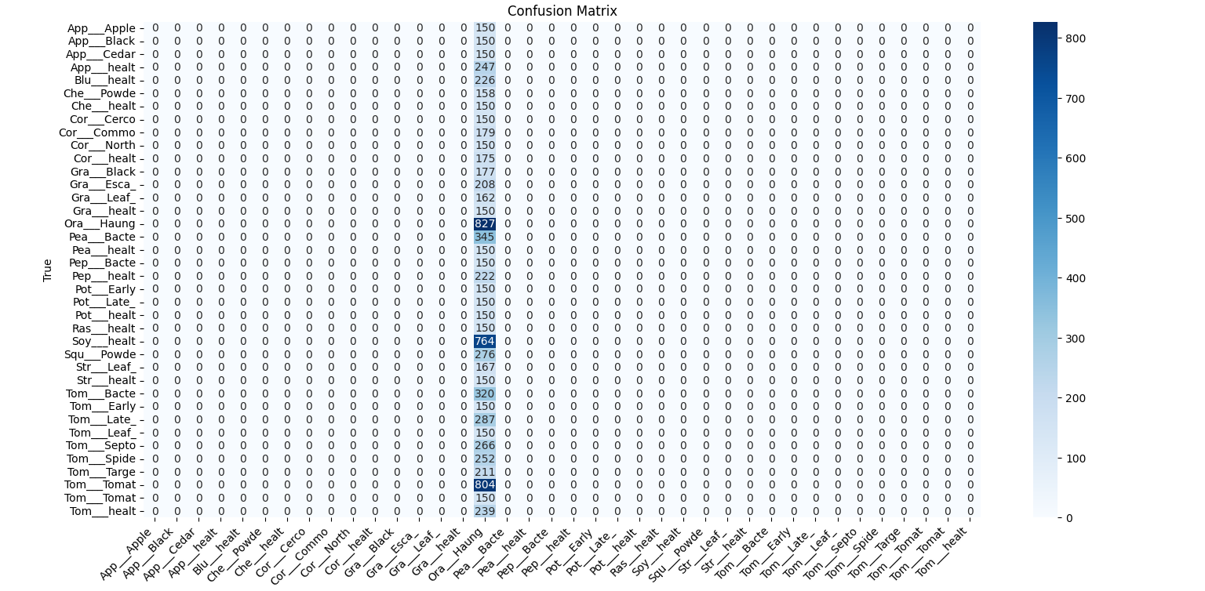
MODEL – EFFICIENTNETB0
Confusion Matrix generated before Undersampling

Slide 26
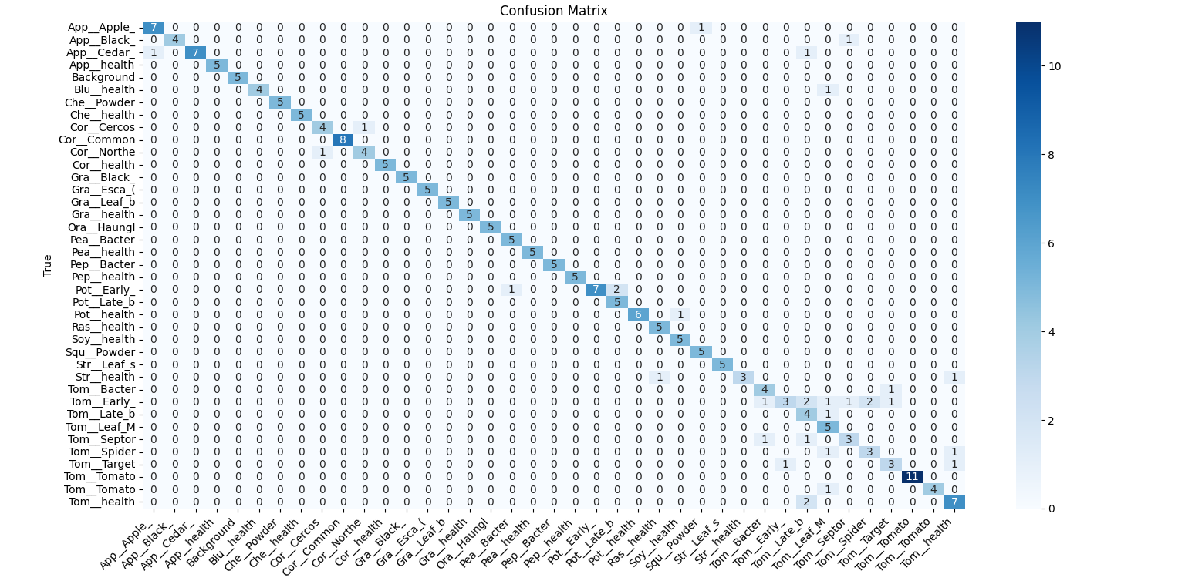
MODEL – EFFICIENTNETB0
Confusion Matrix generated after Undersampling

Slide 27
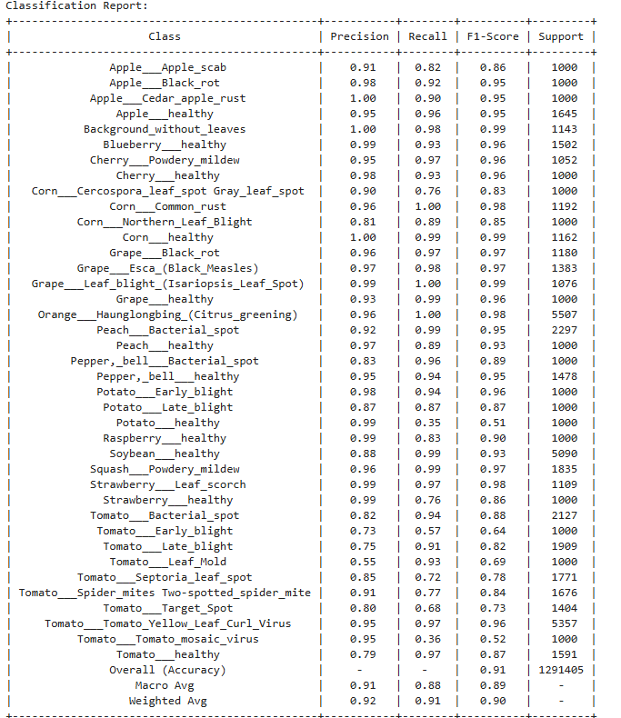
CLASSIFICATION
REPORT FOR
MODEL TRAINED
USING
EFFICIENTNETB0

Slide 28
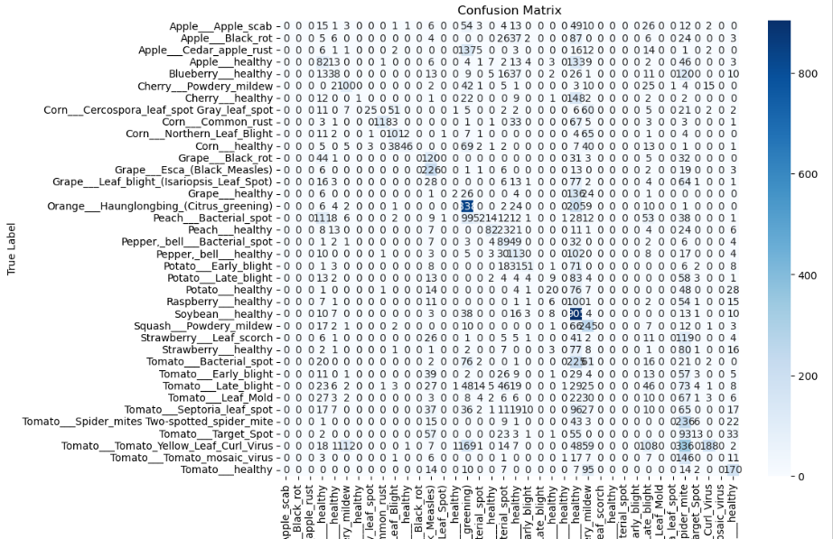
MODEL – RESNET50
Confusion Matrix for model trained using ResNet50

Slide 29
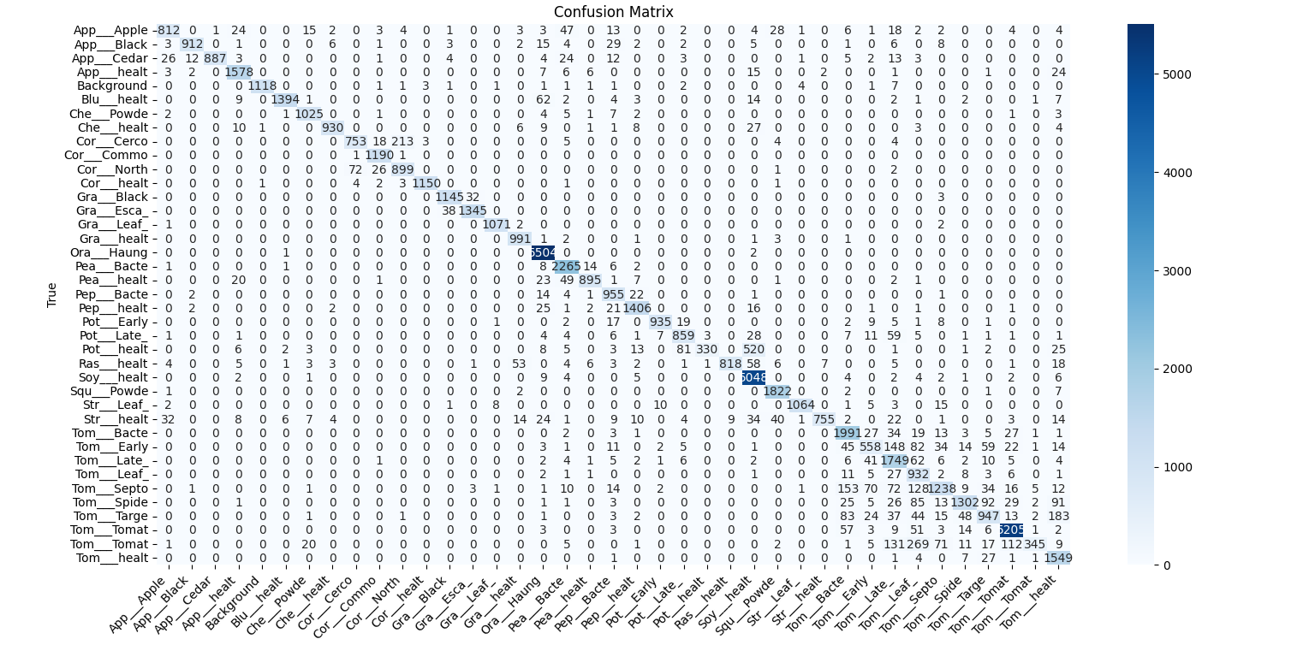
MODEL - MOBILENETV2
Confusion Matrix for Model Trained Using MobileNetV2

Slide 30
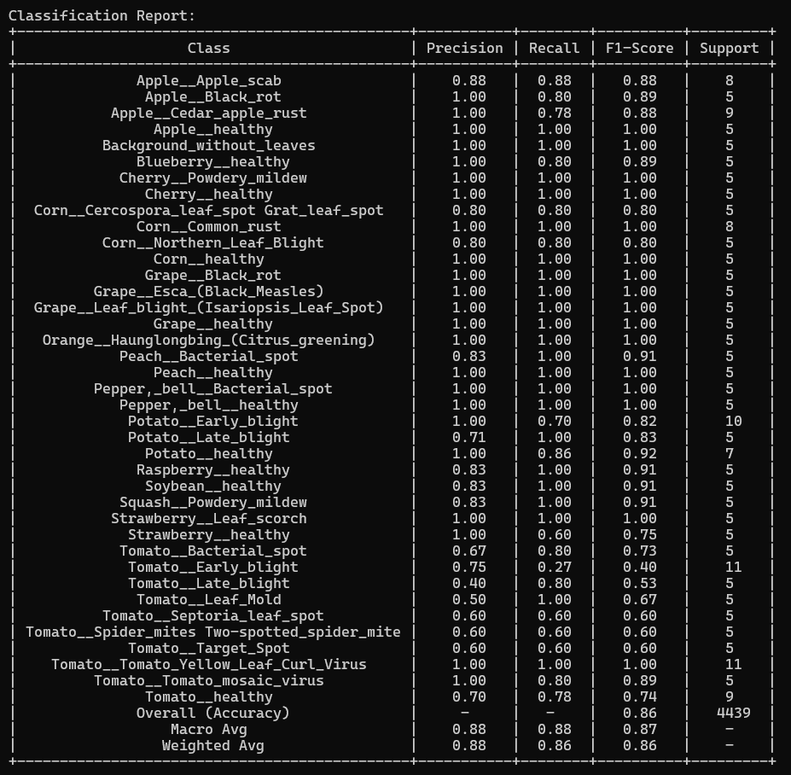
CLASSIFICATION
REPORT FOR
MODEL TRAINED
USING
MOBILENETV2

Slide 31
MODEL PERFORMANCE COMPARISON
Model | Accuracy | Precision | Recall | F1-score
MobileNetV2 | 89% | 88% | 86% | 86%
EfficientNetB0 | 92% | 92% | 91% | 90%
ResNet50 | 74% | 72% | 71% | 73%
EfficientNetB0 achieved the highest scores across all metrics, demonstrating its ability to generalize well even with fewer training epochs.
MobileNetV2 followed closely, maintaining strong precision and recall while being lightweight and efficient.
ResNet50 lagged behind with lower performance, likely due to its deeper architecture requiring more fine-tuning and computational resources.

Slide 32
TRANSFER LEARNING APPROACH
FOR OBJECT DETECTION AND IMAGE SEGMENTATION

Slide 33
OBJECT DETECTION AND INSTANCE SEGMENTATION
Task Type | What it does | Example Output
Image Classification | "This is an image of a diseased leaf" | Just a label
Object Detection | "There’s a diseased area here [x1, y1, x2, y2]" | Bounding box
Instance Segmentation | "These exact pixels are the diseased area" | Mask (like a stencil)

Slide 34
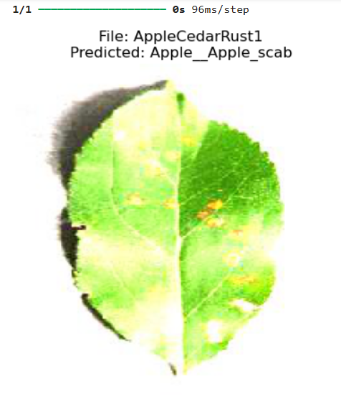
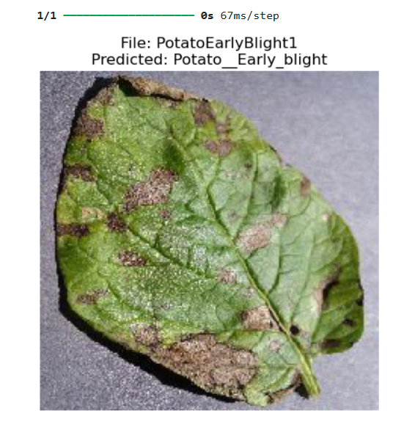
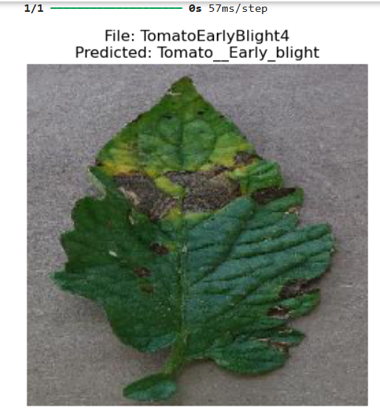
IMAGE CLASSIFICATION

Slide 35
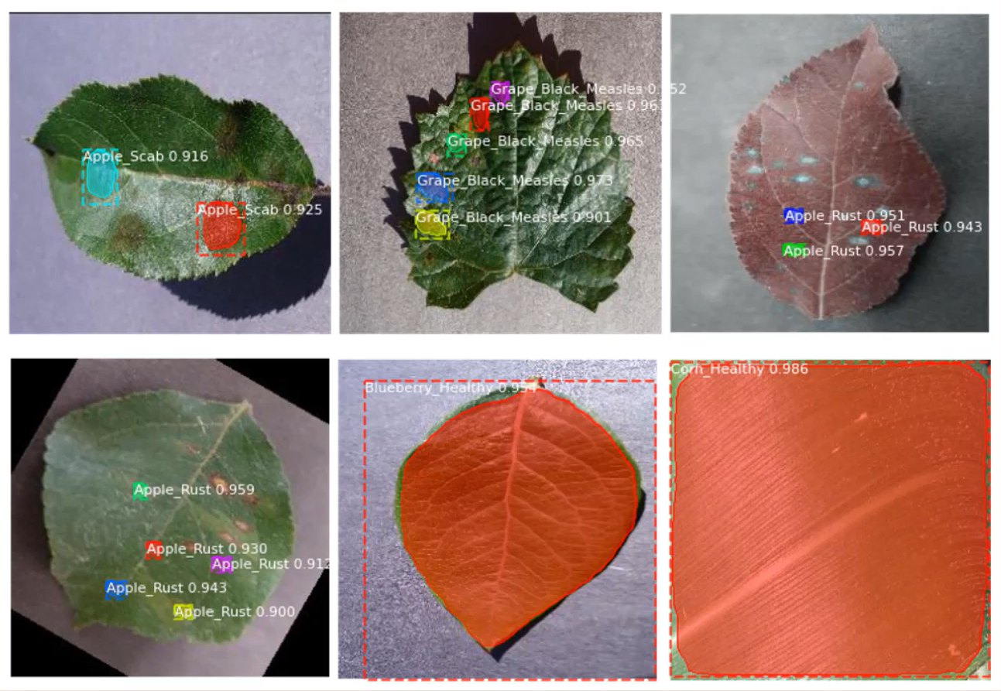
OBJECT DETECTION
AND
INSTANCE SEGMENTATION

Slide 36
DATASET USED
Dataset source: Plant Village Dataset
The original data records contain around 50,000 images.
The custom dataset images span 11 crop species: Apple, Blueberry, Corn, Grape, Peach, Pepper, Potato, Raspberry, Soybean, Strawberry, Tomato.
Number of Classes: 28 (diseased + healthy)
Diseased crop images include 12 fungal diseases, 3 bacterial diseases and 2 mold diseases.

Slide 37
CHALLENGES FACED IN MODEL TRAINING
Overfitting
Overshooting during training
Limited GPU Performance and computational resources
Lack of annotated datasets
Class imbalance in disease categories
Difficulty in model interpretability

Slide 38
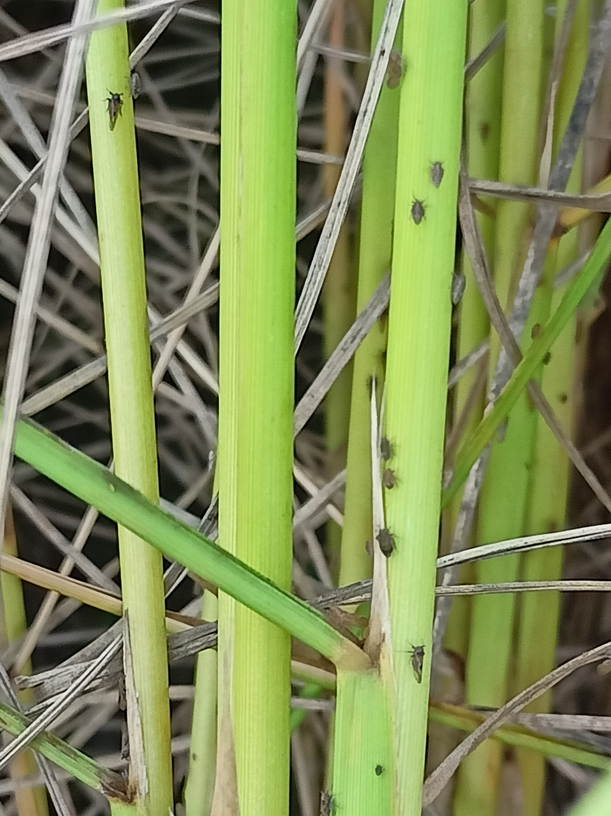
IMPROVEMENT
Rice Planthoppers Detection can be done using fully convolutional neural networks.

Slide 39
IMPROVEMENT
Store all images captured by users
Classify all new images using experts in the field
Regeneration of the neural Network once per month to include all new images.
Apply Drone technology to classify images from the field: Conducts onboard processing allowing farmers to address, almost immediately, any Crop anomalies making the Data collection truly real-time. Also an accurate Plants population count can be conducted.
Create a Blog in local language where farmers can post there infected crop images and collaborate with others to find a cure

Slide 40
REFERENCES
PlantVillage Project: A Deep-Learning App Diagnoses Crop Diseases - Research & Development World
Using Mask R-CNN: https://youtu.be/7ECsYizxC9E?si=MRHPZKq-EiXqZdhJ
Using Deep CNN: https://www.kaggle.com/code/pushkerjain/xception-41
PlantVillage Dataset: https://www.tensorflow.org/datasets/catalog/plant_village
https://www.linkedin.com/pulse/challenges-ai-agriculture-barun-sarkar/?trk=v-feed

Slide 41
GROUP MEMBERS & TEAM GUIDE
Sarthak Shah (UG/02/BTCSE/2021/021)
Tanbir Saha (UG/02/BTCSEAIML/2021/013)
Mr. Ayushman Bilas Thakur
Assistant Professor
Department of CSE
Adamas University
Team guide :
THANK YOU!

